Slide 1
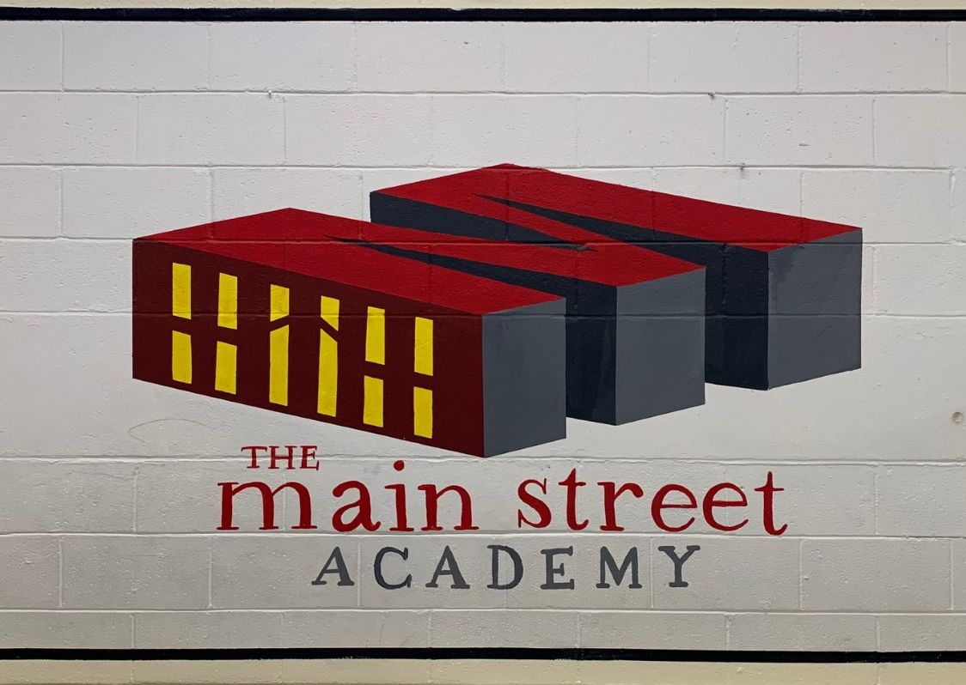
Governing Board Meeting
Managing Principal's Report
May 31, 2022

Slide 2
End Of School Year
'A Special Thanks' to all the staff members that are leaving TMSA for other opportunities. Good Luck and Best Wishes!
A Special Thanks to Ms. Sandra Hunt who has retired form TMSA after 34 years of service.

Slide 3
Summer School
Instructional Program begins on June 6th through June 24th.
150 students Grades 3-8
3rd-31
5th - 44
8th - 39
Grade 8 students will receive an in person invitation from TMSA and information about online option from FCS.
Instructional Day
7:45 am Arrival/Breakfast
8:00 am Instructional Day Begins
30-minute Lunch
12:00 PM Dismissal/Pickup

Slide 4
Summer School

Slide 5
STEAM K-8
FCS Continues K-8 STEAM initiatives
June State of the School Address

Slide 6
Further Planning and Development
Leadership Retreat
Summer Unit/Intergration Planning
Strategic Planning
SIP (School Improvement Planning)
ELA Summer Textbook Adoption
Summer PD Offers

