Slide 1
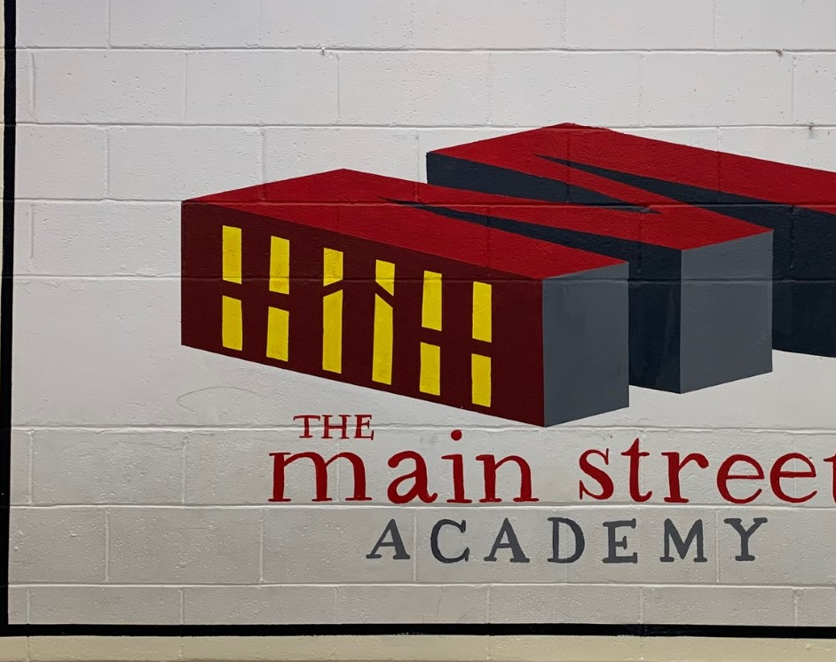
Governing Board Meeting
Principal Report
April 26, 2022

Slide 2
Dates and Events
Geogia Milestones April 25 – May 13
iReady Final Benchmark KG- Grade 8
Administration Professional Day April 27th
Teacher Appreciation May 6th
Grade 8 Festivities
May 7th Dance
May 13th Field Trip
Field Day May 16th and 17th
Grade 5 and 8 promotional celebrations May 18th
End of Year Parties May 19th.
Last day of School May 20th

Slide 3
Health and Safety
MAKO program has ended as of May 21st
Update our Wellness Policy in our parent student handbook.
Healthier Food Option
Monitoring our compliance concerning snacks, food sales, and delivery.

Slide 4
FULL STEAM AHEAD! STEAM Overview STEAM MS Qualification STEAM ES Qualifications

Slide 5
FULL STEAM AHEAD!
STEAM CTAE
(Career, Technical and Agriculture Education)
K-5 CTAE Projects
6-8 High School Prep Flight Paths
High Schools Flight Pathways
West Lake Banneker
Tri Cities North Springs
Global Impact Academy Private Schools Networks
Collegiate Partnership
UGA Extension / 4-H
GT (STEAM/ CEISMC)
CAU (RTV/ Film)
GSU (Junior Achievement)
Morehouse School of Medicine
CIVIC
Local Govt.
ZOO Atlanta
GA Aquarium
NASA
FAA
Atlanta Hartfield
Business
Delta Air Lines
STEAM Core
Healthcare Science- (Physical Therapy, Sports Medicine)
Engineering- (STEAM, Coding, Technology, Robotics,)
Arts- (World Language, Fine Arts, Music, Graphic Design)
Economics-(Marketing, Finance, Business)
Agriculture- (Food, Natural Resources)
Grade 6 Students will take one year of CTAE Career Explorations through connections courses. Connections teachers will deliver the instructional models.
Grade 7 students will take a least one semester of CTAE courses.
Grade 8 students will take CTAE courses and a Grade 9 course will be offered for high school credit.

Slide 6
FULL STEAM AHEAD!
K-5
Career Awareness and Exploration (gadoe.org)
Elementary and Middle School Guidance and Tracking Documents
House Bill 713 mandates a minimum course of study in career education in grades K-12. To support teachers in fulfilling these requirements, the grade specific career awareness activities listed as an indicator on the College and Career Ready Performance Index have been developed to assist students with career awareness. Making successful transitions into satisfying college and career ready options are fundamental tasks for school counselors, teachers, administrators, and advisors. Social skills and the development of workforce readiness behaviors are crucial in career development. Below are the grade-specific required career activities.
Grade 1 (Agriculture, Food and Natural Resources; Transportation, Distribution, and Logistics; Law, Public Safety, Corrections, and Security) Grade 2 (Arts, A/V Technology, and Communications; Health Science; Education and Training) Grade 3 (Hospitality and Tourism; Human Services; Energy) Grade 4 (STEM; Manufacturing; Business Management and Administration; Architecture and Construction) Grade 5 (Finance; Information Technology; Marketing; Government and Public Administration)
Elementary Career Guidance Document
Elementary Career Portfolio
Middle School Career Guidance Document
Elementary School Career-Related Activities Tracking Guide and Form
Middle School Career-Related Assessments and IGP Tracking Guide and Form

Slide 7
Flight Plan For Student Success
Summer School Program 22/23
Begins June 6
Priority Grade 3, 5,8
Did not pass Milestones (ELA/ Math)
Below Grade Level iReady (Reading/Math)
ESY (Special Ed)
Intervention- Grades 3-8 Recommendations
TAG Enrichment

Slide 8
Flight Plan For Student Success
Supporting and Developing Highly Qualified Teachers and Leaders
Integrating STEAM Curriculum

