Slide 1
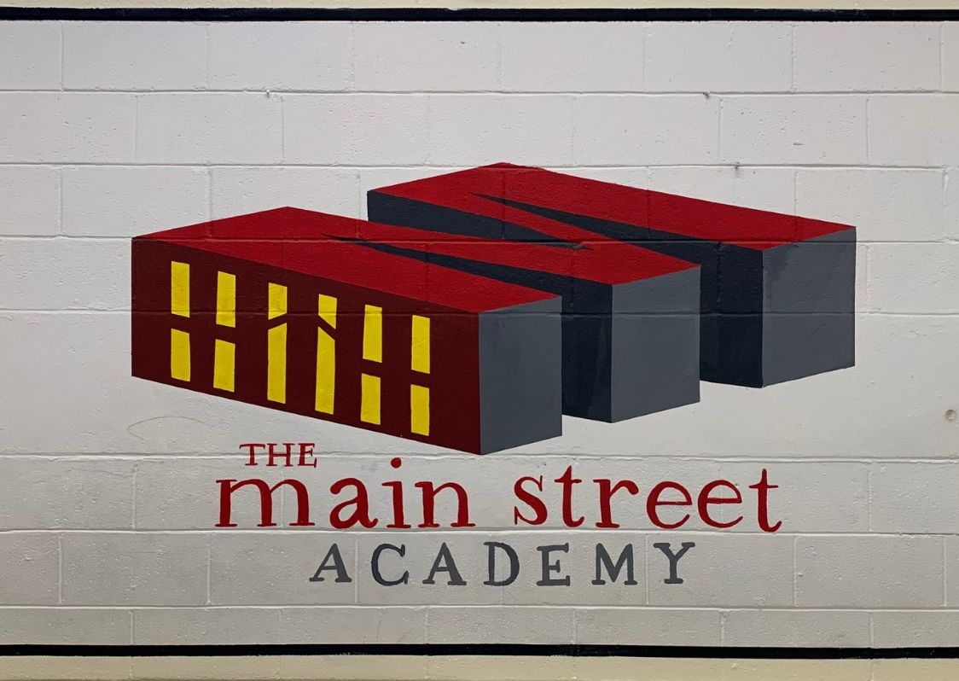
Governing Board Meeting
Principal's Report
January 4, 2022

Slide 2
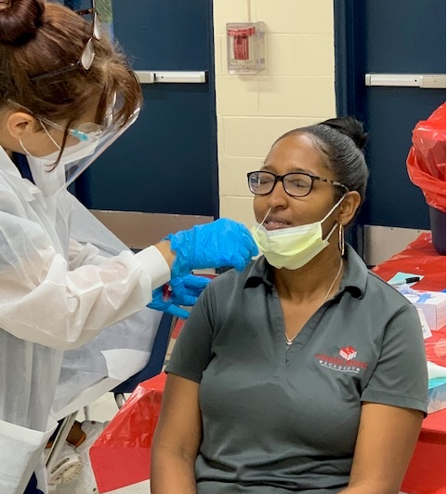
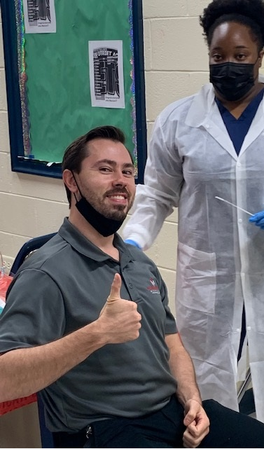
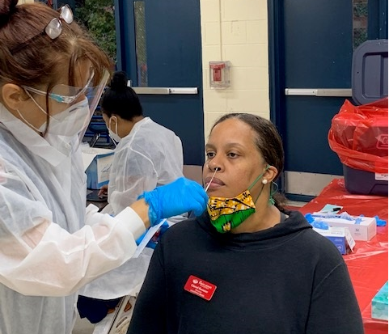
COVID Testing/Surveillance
7-day Moving Average down 51% as of 1/04/22 (1046.6/2065.65).
MAKO testing Monday & Wednesday 8-10 am.
Possible additional day; Thursday.
Required testing for all athletes and cheerleaders. 30% Gym Capacity for basketball games. Parents spectators only.
Mask wearing in highly recommended and encouraged.
Weekly Health and Safety Committee Meetings.

Slide 3
Instructional Updates
Schoolwide Enrichment Model
1/19- SEM Practice Run
1/26- First Day of SEM
3/23- Last Day of SEM
3/30-4/1- Tentative SEM Showcase
Virtual Saturday School began January 22
Virtual Tutorial begins week of January 24th
As part of compliance requirements TMSA will host a virtual ‘State of the School Address’ February 03, 2022, at 6pm
Carline reimagined projected to start February 7th.

Slide 4
Instructional Updates
.
i-Ready Reading Growth
i-Ready Math Growth

Slide 5
22/23 School Year Calendar Results
216 Results
25 - Teacher/Staff Affiliation
191 - Parent/Guardian Affiliation
103 (48%) - Option #1 (First Day of School - August 8, 2022)
66 (31%) - Option #2 (First Day of School - August 2, 2022)
47 (21%) - Option #3 (FCS)
First Day of School: August 8, 2022
Labor Day Break (No school): September 2 & 5, 2022
Professional Development Day (Students do not report to school): October 7, 2022
Indigenous Peoples Day: (No school ): October 10, 2022
Thanksgiving Holidays: November 21 - 25, 2022
Winter Break: December 19, 2022 - January 2, 2023
Teacher Workday (Students do not report to school): January 3, 2023
M.L.K., Jr. Day (No school): January 16, 2023
Teacher Workday (Students do not report to school): February 10, 2023
Presidents Day Break (Students do not report to school): February 17 & 20,2023
Spring Break: April 3 - 7, 2023
Last Day of School: May 26, 2023
Total Instructional Days: 180

Slide 6
Flight Plan For Student Success
Consistent Monitoring of Student and Teacher Performances
Stands Based Practices and Approaches
Data Driven Decision Making processes
Promoting Wellness for our School Community
Parental Engagement and Support

