Slide 1
21- 22 Back To School Wellness Plan:
COVID Mitigation Strategies

Slide 2
Mission
At The Main Street Academy, all students will receive a challenging and enriching education from a dedicated and student-focused staff in partnership with highly-involved parents. Students will leave The Main Street Academy with high expectations of themselves as they prepare for further education and become contributing members of their diverse communities.

Slide 3
Health and Safety Committe
Ishmael Abdul-Salaam, Principal
DeMarco Mitchell, Asst., Principal
Virginia Smith, VP of Operations
Kassandra Jackson, School Nurse
Lacey Nabors, Secretary
Charles Bracey, Building Engineer
Kristy Boazman, Student Services Director
School Social Worker
Travis, Security Officer
Coach Shedric Roberts
Chanel Recasner – Governing Board Member

Slide 4
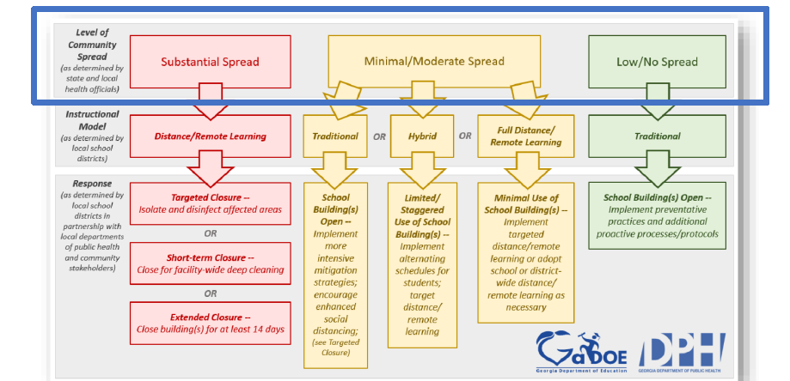
Health Data: Tools that Guide our Decision Making
Our approach to decision making is based on guidance and recommendations of local, state and national public health. It is intended to prioritize the safety and well-being of our students and staff as we start the 2021-22 school year. These recommendations also provide the opportunity for responsive planning to ensure our preparedness to address the changing nature of the COVID-19 pandemic.

Slide 5
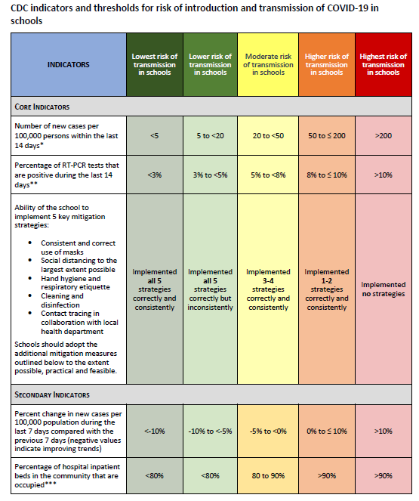

Slide 6
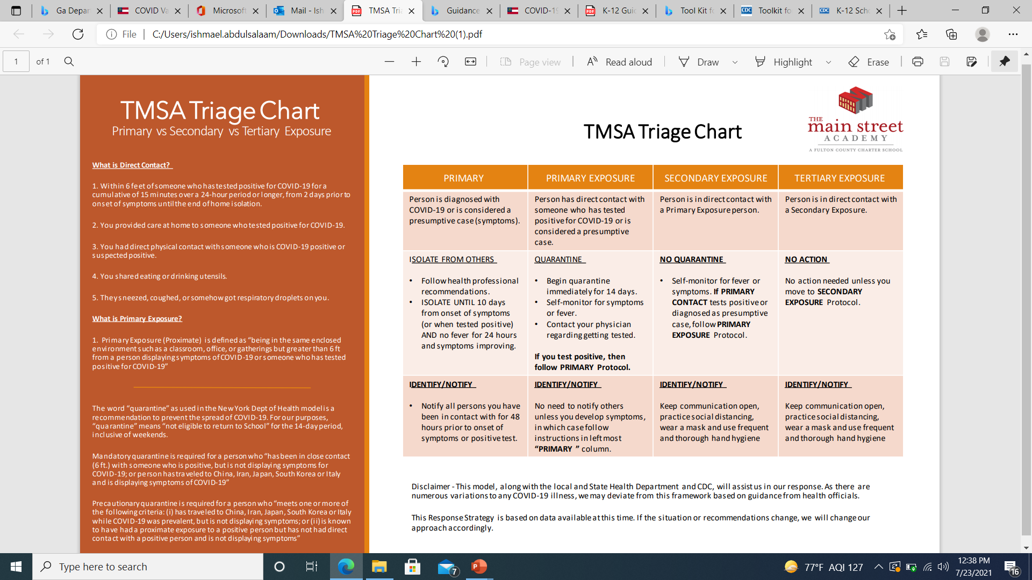

Slide 7
Fulton County 7 Moving Day Average- July 26

Slide 8
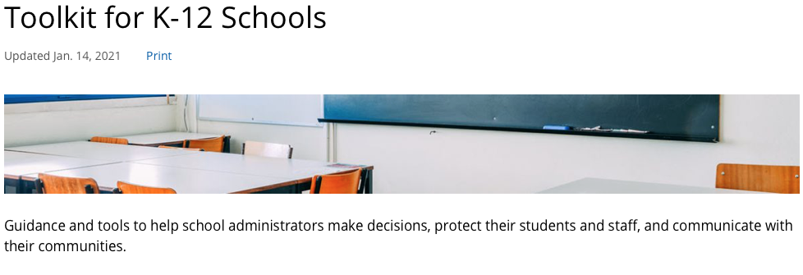

Slide 9
CDC Mitigation Toolkit

Slide 11
CDC Tool Kit and Mitigation Strategies

Slide 12
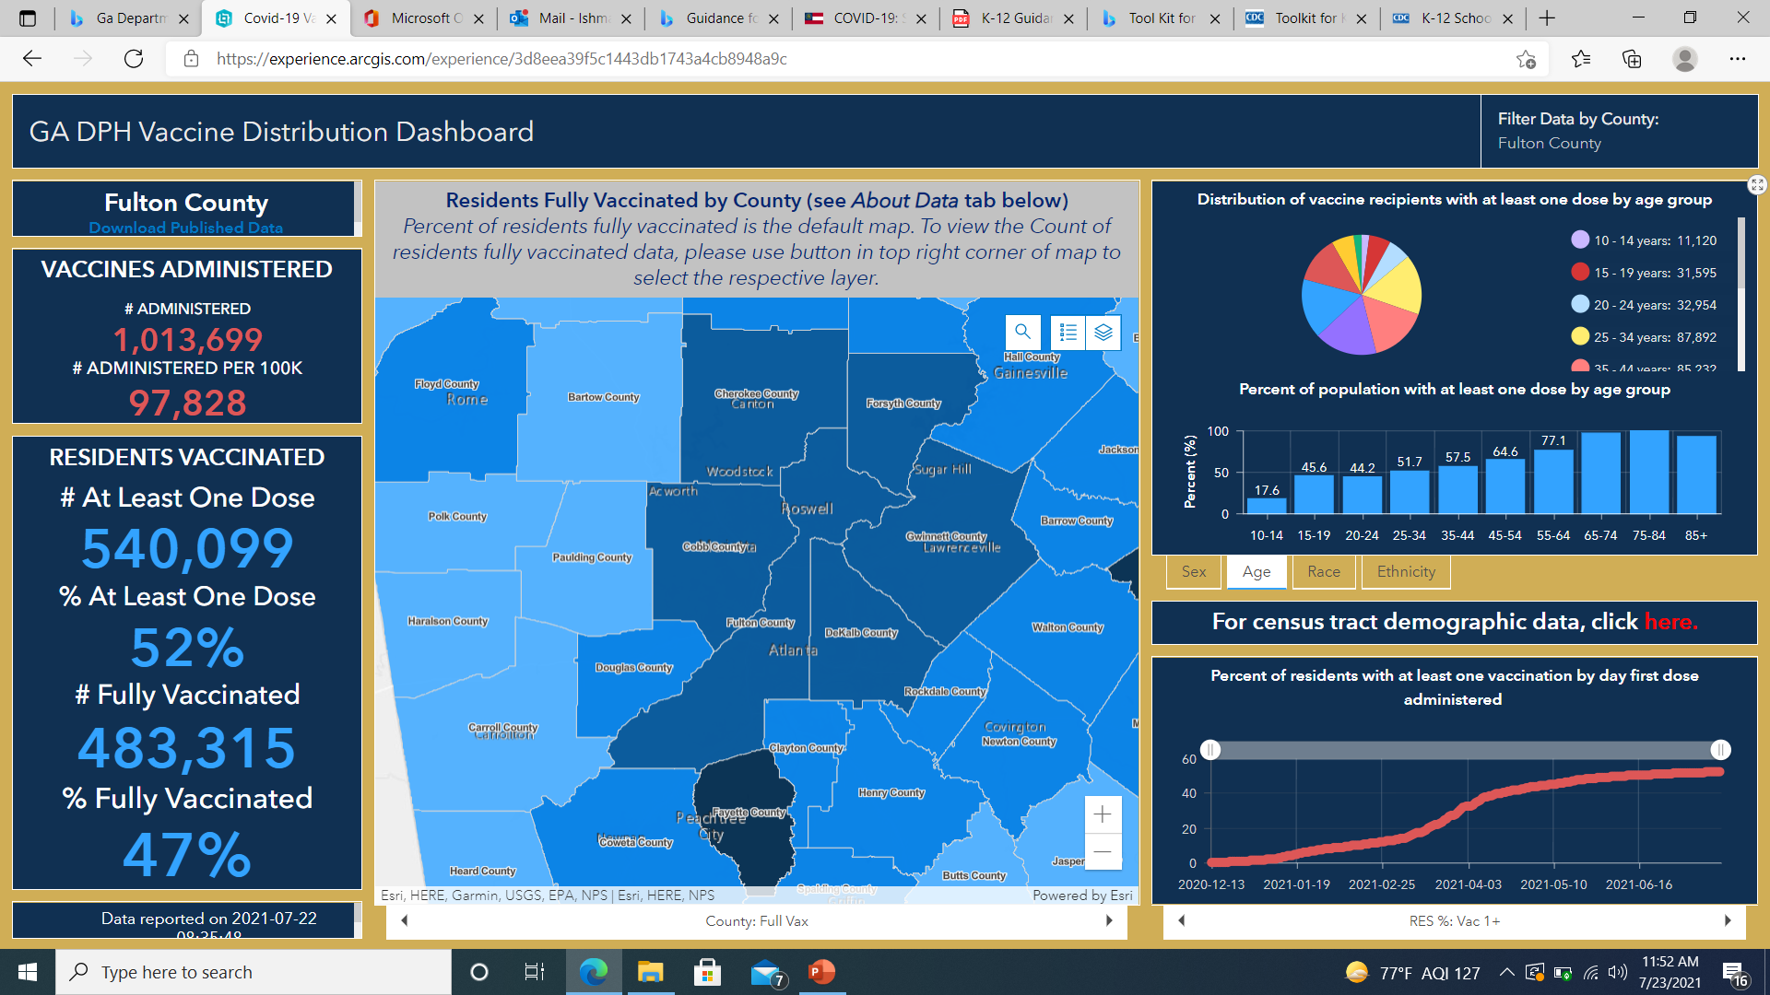
Vaccination Updates
Georgians age 12 and over are eligible to receive the vaccine.

Slide 13
COVID Strategy Summary
TMSA will use the GaDPH and CDC Guidance for K-!2 Schools for safety protocols and procedures
Employees adhere to the TMSA/FCS Mandatory Procedures and the Recommended Health & Safety Procedures (listed below)
Masks enforcement will be in effect for all staff, students and visitor.
Plastic Partitions will be available for all students in class and during lunch.
Mask breaks will be allowed under supervision of staff and outdoor classroom activities will be encouraged as supported in the class lesson plan.
Students and staff will adhere to the 3-6 feet physical (social) distance between themselves and other to the extent as possible.
Sports Activities will be governed by Department of Parks and Recreation, FCS Guidelines for Extracurricular Activities.
Hygienic practices of frequent hand washing, covering mouth when coughing or sneezing, and sanitizing will be encouraged.
TMSA’s instructional model will be teaching face-to-face beginning August 03, 2021 (first day of school)

Slide 14
TMSA/FCS Mandatory Procedures
COVID-19 Reporting
All TMSA/FCS staff and students are required to report (1) a confirmed positive case of COVID-19 (2) a pending COVID-19 test result (regardless of the reason for testing) and (3) a direct contact with person who is COVID-19 positive.
TMSA/FCS employees must use the Employee Reporting Portal (under development; link/instructions coming soon) to make the above COVID-19 report.
TMSA students/parents must use the Parent Reporting Portal to make the above COVID-19 report.
Reporting staff and students must wait for further guidance from the FCS Health Services Team, HR, or public health officials after submitting a report; do not report to work or school.
Employees are not to report to work if they feel ill or have symptoms related to COVID-19. Employees who knowingly report to work while exhibiting COVID-19 like symptoms could face District disciplinary action.
TMSA / The FCS COVID-19 Response Team will case investigate all reports in consultation with public health officials. Staff and students are required to cooperate with response team/public health department nurses and respond truthfully to all questions.
All newly hired employees must report their vaccination status via the TMSA Vaccination Survey when requested by HR only. If you have not completed the survey, please do so now. Existing unvaccinated employees whose status has changed to vaccination may update such by retaking the survey.

Slide 15
TMSA/FCS Mandatory Procedures
COVID-19 Quarantine
All staff and students who meet isolation/quarantine criteria must adhere to the district’s 10-day quarantine directive. Individuals exhibiting symptoms while at work/school will be directed to leave or isolated until they can be picked-up.
Quarantined employees will use their personal sick/personal/vacation leave quota during their absence from work. Employees with no leave quota will be unpaid.
Staff and students who have been fully vaccinated (14 days since the second shot in a 2-dose series or the single dose of the J&J vaccine) and symptom-free do not have to quarantine. Proof of vaccination will be needed.
Staff and students who have tested positive for COVID-19 within the past 3 months, fully recovered, and symptom-free do not have to quarantine. Proof of COVID-19 diagnosis will be needed.

Slide 16
Recommended Health & Safety Precautions
FCS strongly encourages ALL EMPLOYEES and students (12 years and older) to get vaccinated against the COVID-19 virus. By being fully vaccinated, employees can avoid having to quarantine (due to direct contract) and using their personal/sick/vacation leave quota. Per the CDC, vaccination is the leading public health measure for preventing COVID-19 infection. The following is a link to DPH on COVID-19 Testing and Vaccine information: COVID-19 Testing in Georgia | Georgia Department of Public Health and COVID Vaccine | Georgia Department of Public Health.
Mask wearing remains optional for FCS students and staff, except on FCS school buses. If one is not fully vaccinated, wearing a mask/face covering in indoor public places is recommended.
Students and staff should continue to keep a physical (social) distance of 3-6 feet between themselves and others to the extent possible.
Staff and students should wash their hands frequently and cover their mouth/nose when coughing and/or sneezing.

Slide 17
Recommended Health and Safety Precaution (Cont.)
5.High touch areas and personal workspaces should be cleaned and disinfected frequently.
6.District facilities and schools should limit non-essential visitors, volunteers, and activities involving external groups or organizations with people who are not fully vaccinated. All school/facility visitors must complete a wellness check.
7.Employees should limit non-essential meetings/staff gatherings and use MS Teams when possible/work conducive.
8.All personnel should reference the CDC website for ongoing information regarding COVID-19, particularly in the K-12 environment(s). Guidance for COVID-19 Prevention in K-12 Schools | CDC.

Slide 18
Schedules (Kinder. – 4th Grade)
Kindergarten – 2nd Grade
Time | Class/Activity
7:45 AM | Homeroom – Morning Announcements
8:00 – 9:15 AM | Reading or Math
9:25 – 10:40 AM | Math or Reading
10:50 – 11:20 AM | Leader in Me & SEL
11:30 – 12:30 PM | School-wide Lunch & Recess
12:40 – 1:40 PM | Flexible Grouping
1:50 – 2:50 PM | Specials
3:00 – 3:30 PM | Science or Social Studies
3rd & 4th Grade
Time | Class/Activity
7:45 AM | Homeroom – Morning Announcements
8:00 – 9:15 AM | Reading or Math
9:25 – 10:40 AM | Math or Reading
10:50 – 11:20 AM | Leader in Me & SEL
11:30 – 12:30 PM | School-wide Lunch & Recess
12:40 – 1:40 PM | Specials
1:50 – 2:50 PM | Flexible Grouping
3:00 – 3:30 PM | Science or Social Studies

Slide 19
Schedules (5th – 8th Grade)
5th Grade
Time | Class/Activity
7:45 AM | Homeroom – Morning Announcements
8:00 – 9:15 AM | Reading or Math
9:25 – 10:40 AM | Math or Reading
10:50 – 11:30 AM | Leader in Me/SEL or Flexible Grouping
11:30 – 12:30 PM | School-wide Lunch & Recess
12:40 – 1:40 PM | Specials
1:50 – 2:35 PM | Science or Social Studies
2:45 – 3:30 PM | Social Studies or Science
6th – 8th Grade
Time | Class/Activity
7:45 AM | Homeroom – Morning Announcements
8:00 – 9:30 AM | Specials
9:45 – 10:45 AM | Core 1
11:00 – 11:30 AM | Leader in Me/SEL
11:30 – 12:30 PM | School-wide Lunch & Recess
12:40 – 1:40 PM | Flexible Grouping
2:00 – 3:30 PM | Core 2

Slide 20
Implementation
Car Line
Food*
Breakfast and lunch provided at no charge
Consistent Schedules
7:45 AM – 3:30 PM Daily
Safety Precautions
Employees, students and visitors are required to wear Mask
Disinfecting between Face-to-Face appointments
Before/After Care
Before & After School Program will resume the first day students return to campus
Students will wash/sanitize their hands before and after mask removal
Parents will follow the current car line directions for drop-off and pick-up
Social distancing standards (3 Ft. / 6 Ft.)
Monday – Friday | Face-to-Face
Desk shields will be provided for every class and student.

Slide 21
Additional COVID-19 Safety Procedures
We ask that all families screen their children before dropping them off at school.
6 feet markers will be placed on the floor around the building and outside of the building for our students to learn appropriate distance and navigation of the hallways.
All students, faculty and staff must wear face masks during the day. Face shields will not be accepted as sole protection but can be worn secondary protection.
Students will use a seating chart in class/pod. Seating charts will remain the same.
Hand sanitizer stations are in numerous places around the building and students will be reminded to use them as often as possible.
Classrooms, restrooms, and all high touch areas will be disinfected throughout the day.
Disinfectant spray and/or wipes will be provided for every classroom on campus.

Slide 22
Car Line Procedures
Parents will follow the current car line directions for drop-off and pick-up.
Dismissal will occur in blocks of 10 families (car line number) at a time to avoid crowding.
Parents will not be allowed to walk children into the building unless authorized.

Slide 23
Morning Arrival Procedures
We will open our doors at 7:30 AM. Remember, for student safety, do not drop off early.
To ensure everyone's safety, parents will not be able to leave their cars when dropping off.
Staff will be strategically placed outside and around the building to welcome students and escort them directly to their destination.
Due to safety protocols, parents are not able to walk their children to class.
Alcohol-based hand sanitizer will be available at all entrances to the building as students will need to sanitize their hands as they enter.
Grab-and-go breakfast will be served at 7:45 AM.

Slide 24
Cafeteria / Lunch Procedures
Hand sanitizing stations will be at the entrance and exit to the cafeteria.
Students must wear their masks in line and store them away safely when they are eating.
All tables in the cafeteria will be labeled with seats spaced appropriately apart.
All meals will be rung up using barcodes or name recognition for each student.
Students need to be able to readily share their first and last name when asked.
Students will communicate with the cafeteria servers their selections so that food items can be placed on the tray.
Custodial staff will disinfect cafeteria tables between groups.

Slide 25
Classroom Procedures
Every classroom has a hand sanitizing station or liquid for student and staff use.
Students will be referred to the nurse if symptoms are present for any illness.
Teachers will keep classroom doors open to improve circulation in the building.
Students will have assigned desks in the classroom that are apart and near a plug to ensure their device has power.
Supplies will not be shared.
Plastic shields will be placed in every classroom for teachers to safely host small group instruction.

Slide 26
Hallway Movement Procedures
Every hallway has two or more hand sanitizing stations for student and staff use.
Students will follow the normal right side of hallway flow of traffic.
Students will physical (socially) distance at 6 Ft while walking in the hallway.

Slide 27
Health Services Procedures
Department of Public Health will be contacted if staff or a student is diagnosed with a positive COVID-19 test.
TMSA will notify all employees, students and families if a lab-confirmed COVID-19 case is identified on campus. Anyone who had close contact with the affected individual will receive individual notification. A close contact is defined as any individual who was within six (6) feet of an infected person for at least 15 minutes.
Due to privacy requirements, TMSA will not identify any individual who tests positive for COVID-19.
If a student develops COVID-19 symptoms on campus, he/she will be escorted to the school clinic and remain in the isolation room until a parent arrives within an hour.
Check in with your child each morning for signs of illness. If your child has a temperature of 100.4 degrees or higher prior to use of fever reducing medication, sore throat or other signs of illness, like a cough, diarrhea, severe headache, vomiting, or body aches, he/she should not go to school. Contact your family physician and notify Nurse Jackson at TMSA.
If your child has had close contact to a COVID-19 case, he/she should not go to school.
All families will follow the Self-Screen Guidelines prior to reporting to school each morning.

Slide 28
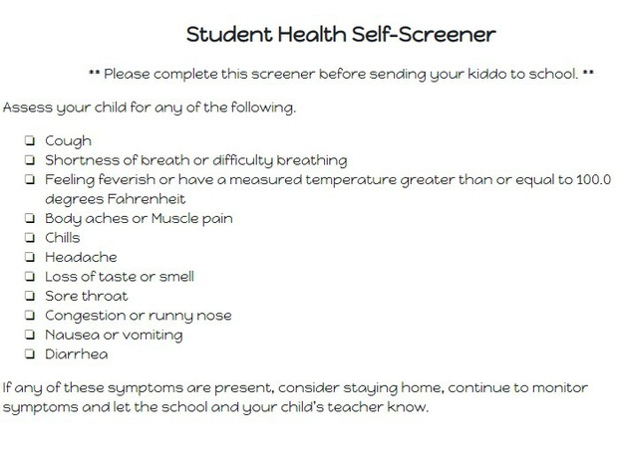
Health Services Procedures
If your child has any symptoms listed below, please keep your child home and contact your family physician.

Slide 29
Dismissal Procedures
Sanitizer stations are located at each exit and students will be asked to sanitize before they leave.
Parents picking up in the car rider line must remain in their cars during dismissal.
All parents will receive a numbered placard to hang on their rearview mirror.
Parent pick-up students will be called from their classrooms to the dismissal area in the rear of the building.
After School Program students will remain in their classrooms until the ASP teacher arrives to escort to a designated area (i.e. cafeteria).

Slide 30
Additional Information
CLOSED CAMPUS UNTIL FURTHER NOTICE
We will remain a closed campus until we feel it is safe to welcome visitors back.
STUDENTS ON CAMPUS WILL GO TO RECESS and Have Mask Break periods
Students will use hand sanitizer or wash hands before and after recess.

Slide 31
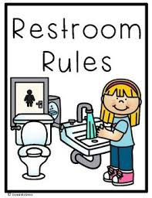
Additional Information
STUDENTS NEED TO BRING A REUSABLE WATER BOTTLE EVERY DAY
Please clearly label your child's water bottle, fill it with water, and send it with your child every day. Water fountains will only be available to fill water bottles.
RESTROOMS USE
Restrooms inside of classrooms and hallways will be used. Students will wash their hands before and after restroom use. Students will use restrooms in a socially distant manner.

Slide 32
Additional Information
DEVICES AND HEADPHONES
All students returning to campus must bring their TMSA device with power cord and headphones.
UNIFORMS
Students are required to wear our school uniform during Face-to-Face learning.

Slide 33
School Closing Matrix
FCS Closing Matrix
LEVEL 1 1-2 Students or 1-2 Staff Members POSITIVE COVID DIAGNOSIS | LEVEL 2 3+ Students or Staff Members POSITIVE COVID DIAGNOSIS SAME SITE | LEVEL 3 ADDITIONAL FACTORS AS DETERMINED BY PUBLIC HEALTH SUCH AS COMMUNITY SPREAD / GADPH INTERVENTION
ISOLATE / INVESTIGATE / DISINFECT ISOLATE INDIVIDUALS AS NECESSARY EXCLUDE INDIVIDUALS CONDUCT INTERNAL CASE INVESTIGATIONS LEARNING CONTINUES IN CURRENT DELIVERY MODEL FOR THOSE NOT IMPACTED IMPACTED AREAS WILL BE DISINFECTED COMMUNICATIONS AS NECESSARY CASE EVALUATIONS WILL BE EVALUATED INDEPENDENTLY | ISOLATE / INVESTIGATE / DISINFECT ISOLATE INDIVIDUALS AS NECESSARY EXCLUDE INDIVIDUALS CONDUCT INTERNAL CASE INVESTIGATIONS LEARNING CONTINUES, BUT MODEL MAY CHANGE TO “REMOTE” AS NEEDED IMPACTED AREAS WILL BE DISINFECTED COMMUNICATIONS AS NECESSARY CASE EVALUATIONS WILL BE EVALUATED INDEPENDENTLY BASED UPON CASE INVESTIGATIONS, IMPACTED AREA / SITE MAY CLOSE UP TO 72 HOURS TO ALLOW FOR PUBLIC HEALTH CONTACT TRACING | CLOSURE SITE, ZONE, OR DISTRICT CLOSED BASED UPON CASE INVESTIGATIONS AND COORDINATION WITH PUBLIC HEALTH OFFICIALS LEARNING CONTINUES, BUT MODEL MAY CHANGE TO “REMOTE” AS NEEDED NON- INSTRUCTIONAL / SCHOOL DISTRICT OPERATIONS CONTINUE COMMUNICATIONS AS NECESSARY
The district’s decisions will be based upon guidance and data from partnering public health agencies.
January 2021 | Full Day Face-to-Face for all

Slide 34
Timeline
July 27th –August 2nd | Pre-Planning
July 30th (3-4:30 pm K thru 4) (5-6:30 pm 5 thru 8) | Sneak-A-Peak ( A virtual option will be available and encouraged to minimize the amount of traffic in the school. Grades 4 thru 8 are encouraged to use the virtual or recorded options unless they are new to TMSA.)
August 3rd | First Day of School
September 27th – October 2nd | Fall Break
August 3rd thru December 17th | Semester 1
December 20th – January 3rd | Winter Break

Slide 35
References
Centers for Disease Control and Prevention
https://www.cdc.gov/
Georgia Department of Public Health
Georgia Department of Public Health
Fulton County Schools
https://www.fultonschools.org/

