Slide 1
Employee Survey Results
TMSA School Wide Survey of Employees
February 2021

Slide 2
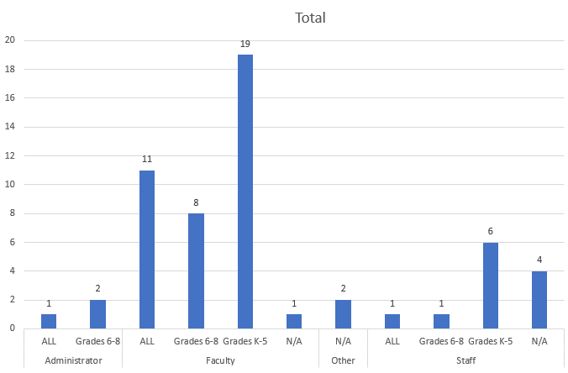
Survey Context
This survey was voluntarily undertaken and includes 56 respondents;
3 Administrators
39 Faculty
19: Grades K-5
8: Grades 6-8
11: All Grades
1: N/A
12 Staff
2 Other

Slide 3
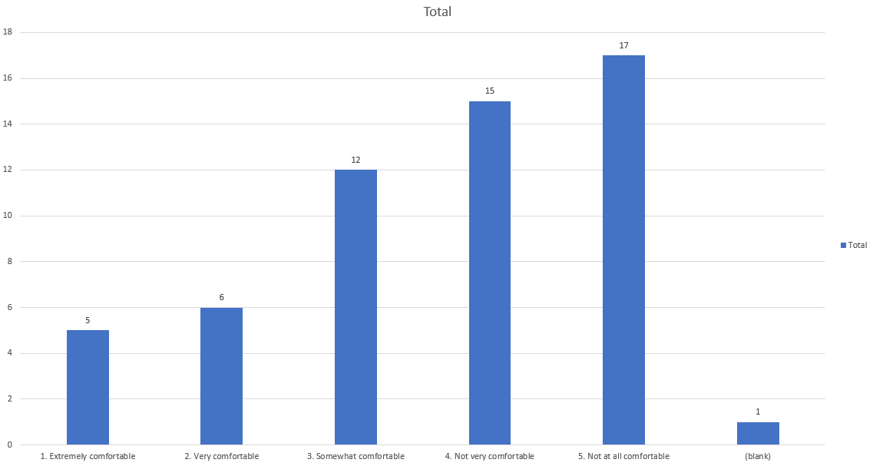
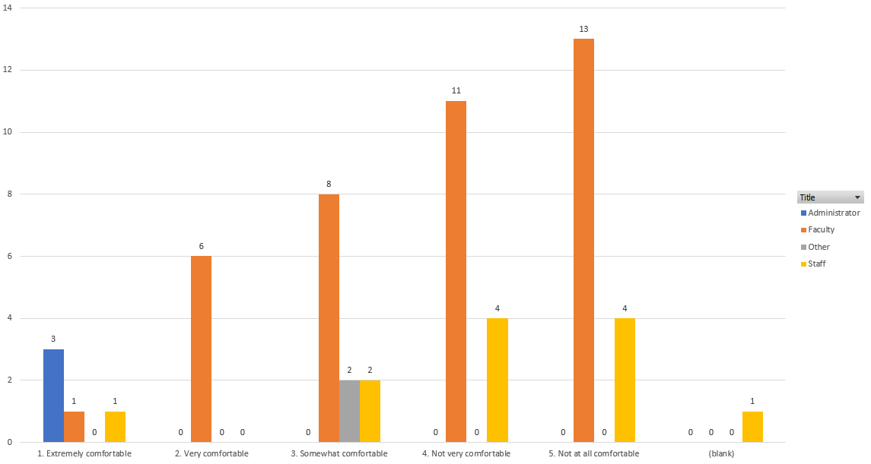
Comfortable Returning Face-To-Face (With TMSA Implementing Safety Measures)
**Respondent data manipulated to give order to selection. Preceding number added prior to each answer type.

Slide 4
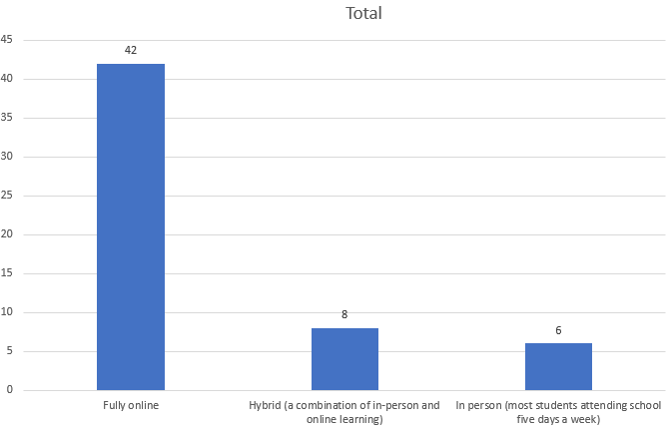
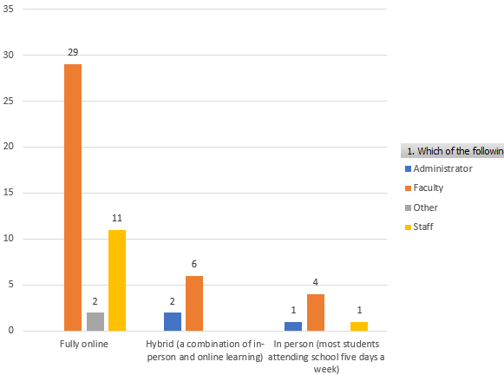
Learning Approach Preferred – Rest of Semester

Slide 5
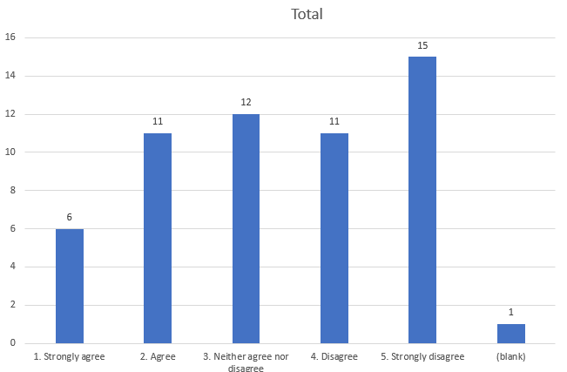
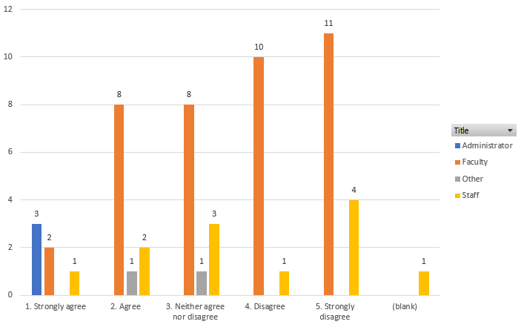
“I feel well informed about the safety measures being taken to allow students to return.”
**Respondent data manipulated to give order to selection. Preceding number added prior to each answer type.

Slide 6
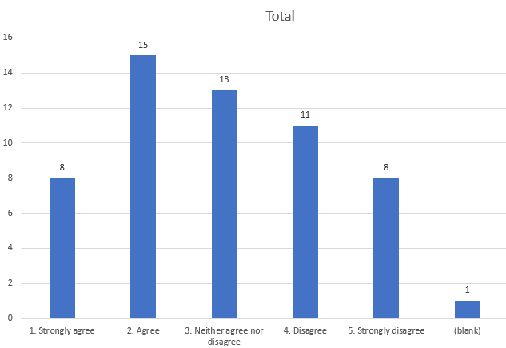
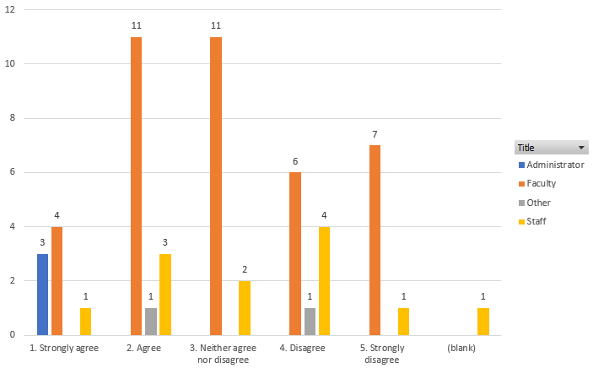
“I have the materials and resources needed to perform my job safely at school during the pandemic.”
**Respondent data manipulated to give order to selection. Preceding number added prior to each answer type.

Slide 7
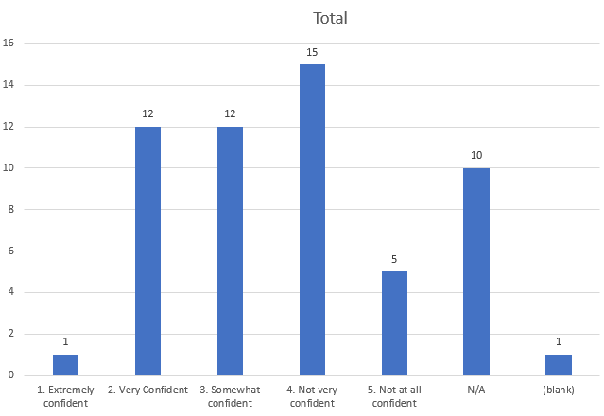
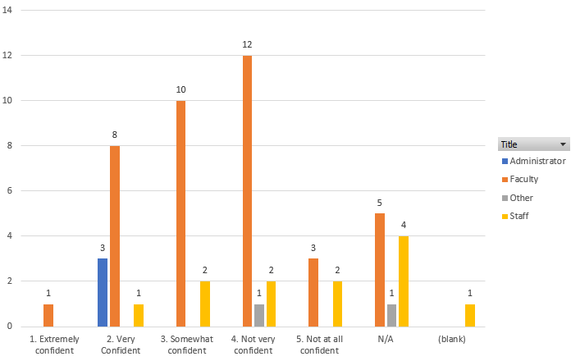
“How confident are you that you will be able to accomplish the following tasks when teaching in person during the pandemic? – Teaching effectively while following safety protocols.”
**Respondent data manipulated to give order to selection. Preceding number added prior to each answer type.
*Example provided in survey is wearing a mask while teaching.

Slide 8
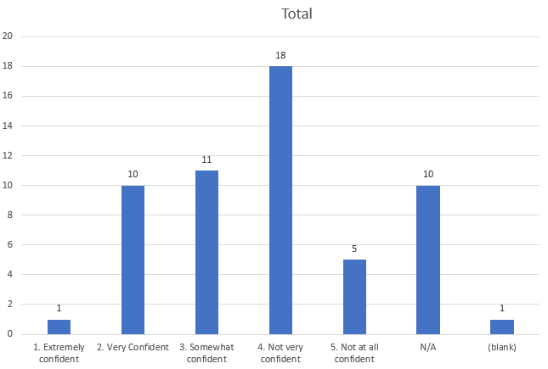
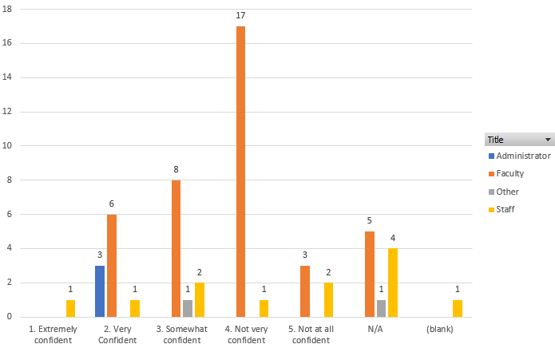
“How confident are you that you will be able to accomplish the following tasks when teaching in person during the pandemic? – Managing/enforcing safety protocols among students.”
**Respondent data manipulated to give order to selection. Preceding number added prior to each answer type.

Slide 9
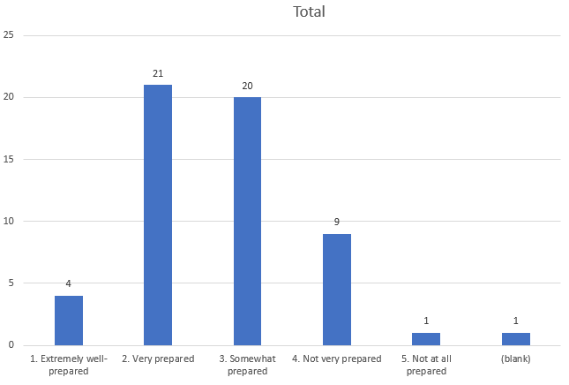
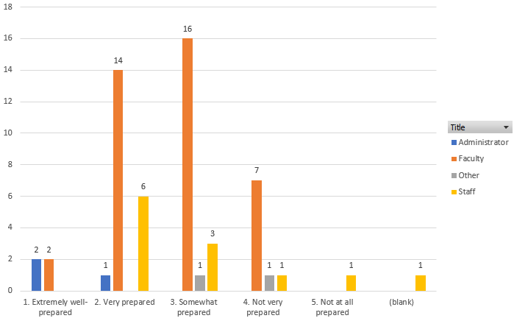
“How prepared are you to address the following needs of students? Ensuring students are on track academically.”
**Respondent data manipulated to give order to selection. Preceding number added prior to each answer type.

Slide 10
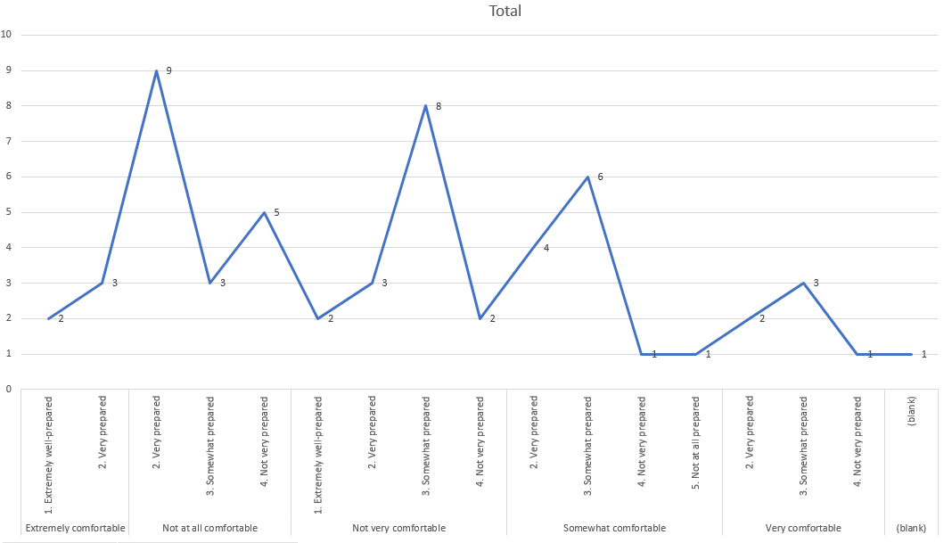
Overlay of Preparedness – Academic Delivery and Comfort Returning
In essence what we learn here is that there is no correlation between the comfort of returning, and how prepared an educator is to deliver education.

Slide 11
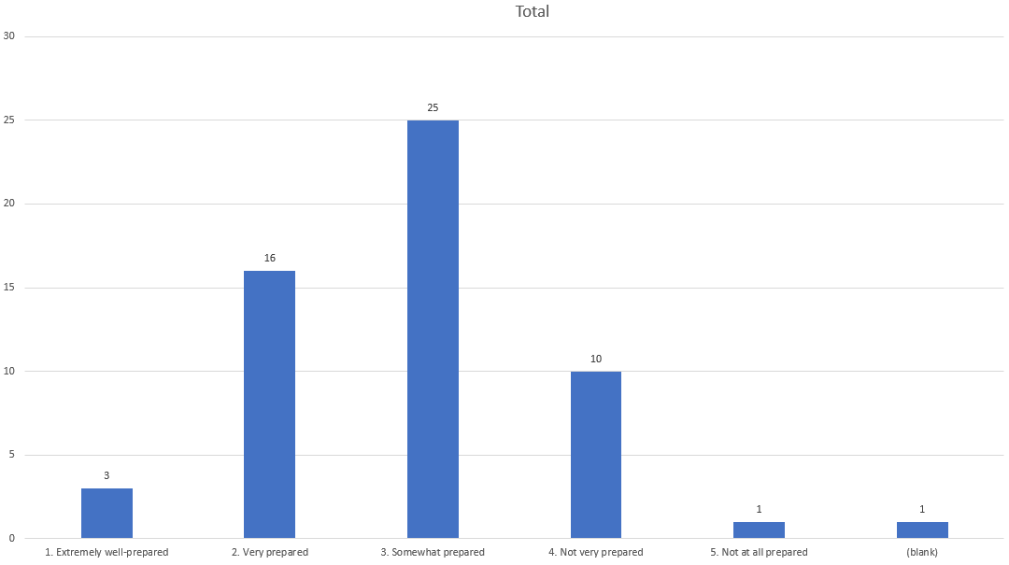
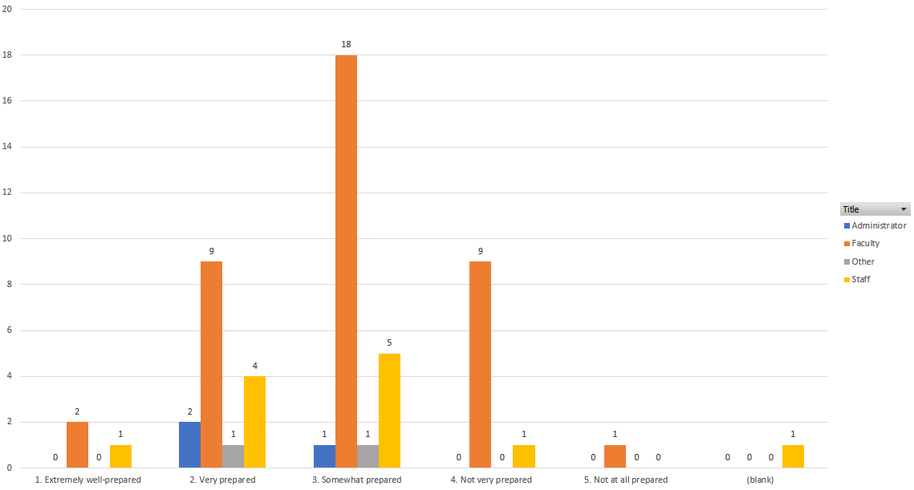
“How prepared are you to address the following needs of students? Supporting Student’s Social and Emotional Needs.”
**Respondent data manipulated to give order to selection. Preceding number added prior to each answer type.

Slide 12
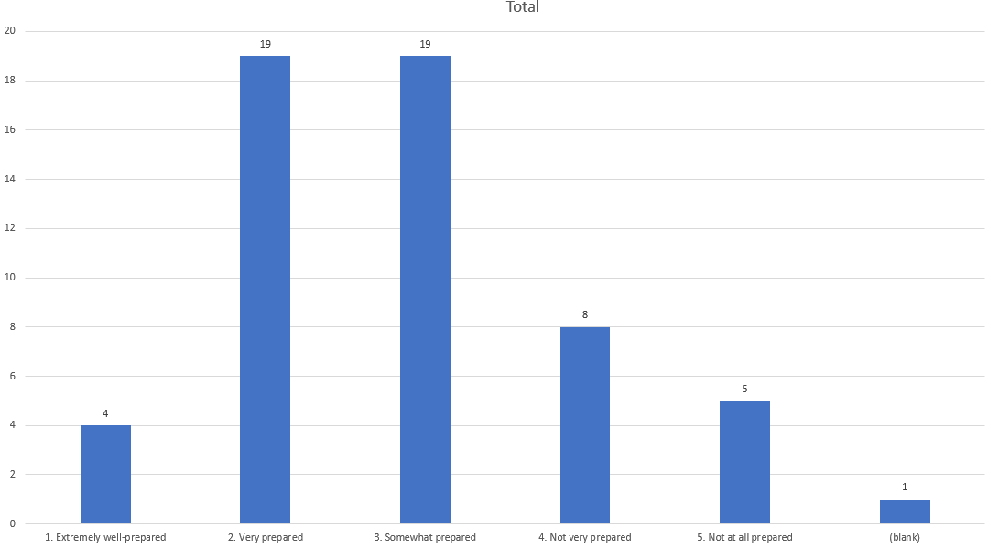
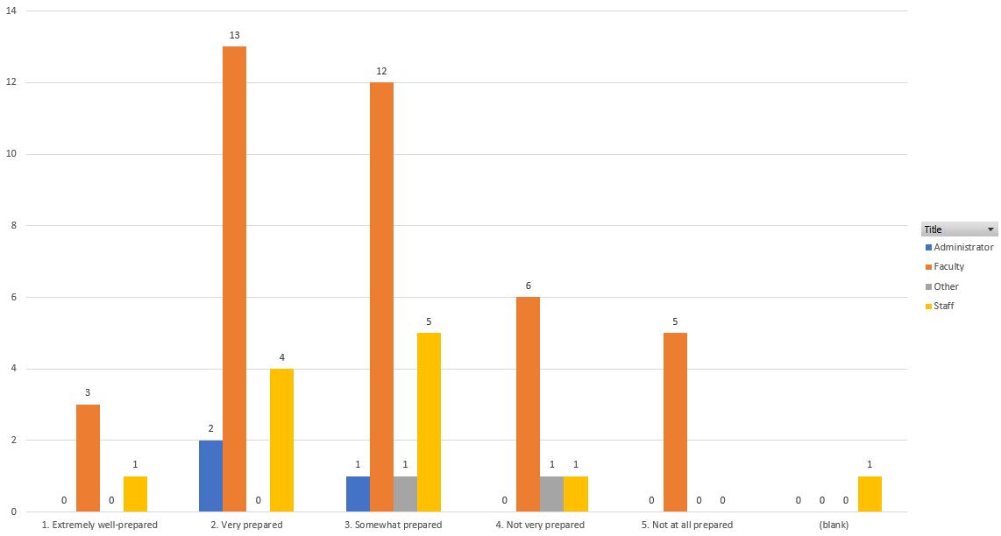
“How prepared are you to address the following needs of students? Handling Student Behavioral Issues.”
**Respondent data manipulated to give order to selection. Preceding number added prior to each answer type.

Slide 13
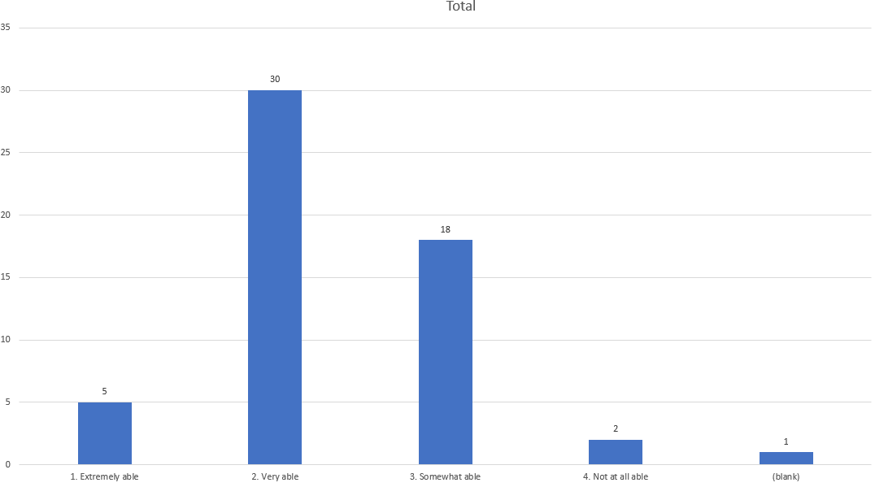
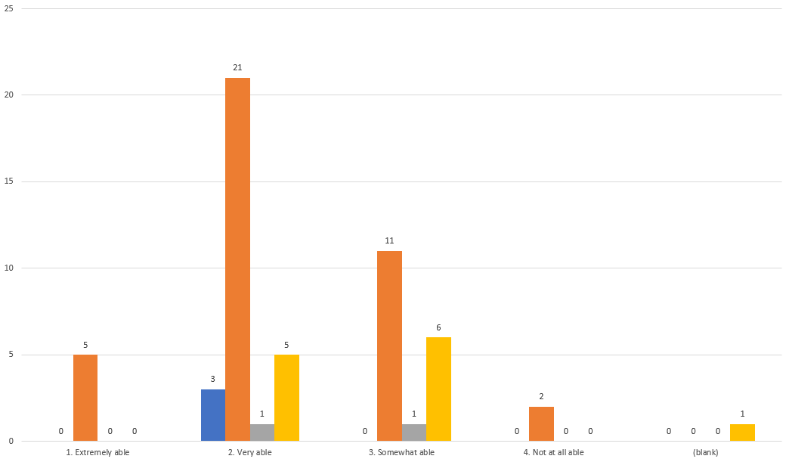
“As you think about future learning, to what degree are you able to successfully partner with parents/Families to support student learning?”
**Respondent data manipulated to give order to selection. Preceding number added prior to each answer type.

Slide 14
How can our school best support you in your role as school reopens?

Slide 15
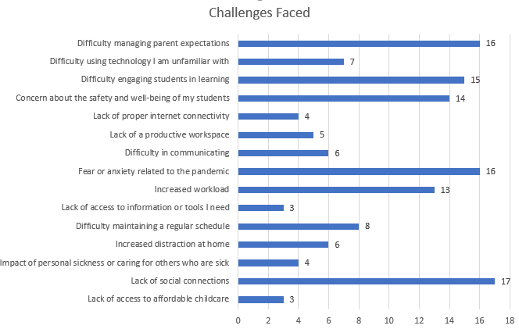
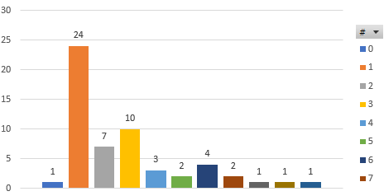
Which of the following challenges have you encountered while working remotely? Please select all that apply.
Respondents were offered 16 potential Challenges.
1 respondent selected 0: may indicate “I did not encounter any challenge while working remotely”
Two respondents indicated “I did not encounter any challenges while working remotely” and “Lack of access to affordable childcare” as well as “Difficulty managing parent expectations”

Slide 16
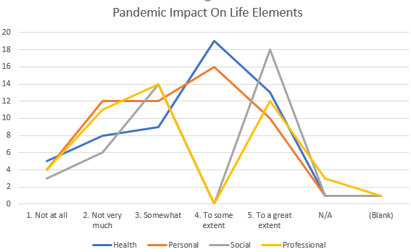
To what extent is the pandemic negatively impacting the following areas of your life? Health, Personal, Social, Professional
**Respondent data manipulated to give order to selection. Preceding number added prior to each answer type.

Slide 17
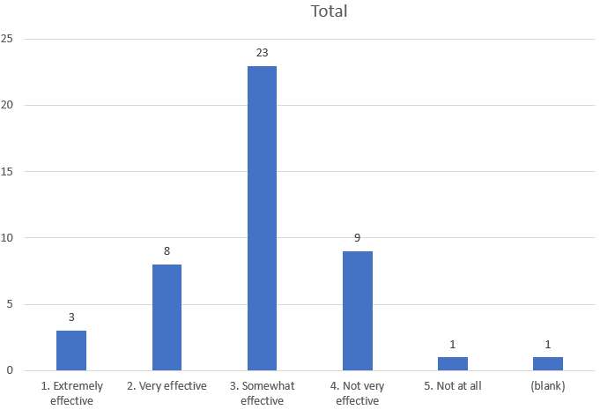
Please rate the effectiveness of the availability of mental health supports for teachers.
Only includes respondents who indicated that they teach in question 2.
**Respondent data manipulated to give order to selection. Preceding number added prior to each answer type.

Slide 18
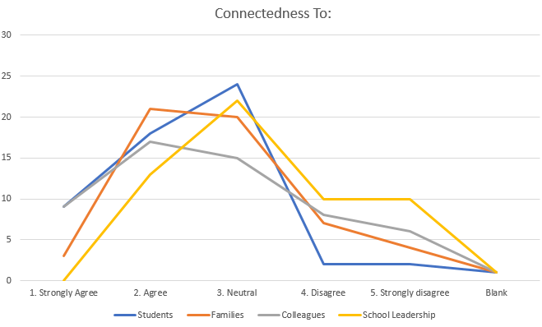
To what degree do you agree or disagree with the following statement with respect to the following members of our community: I have felt a connection with this group during the pandemic:
**Respondent data manipulated to give order to selection. Preceding number added prior to each answer type.

Slide 19
Word Cloud of Question 30

