Slide 1
Head of School’s Report for August
August 24, 2021

Slide 2
FABULOUS FOUR
Shared Learning Expectations (Academics)
Ten for Ten
Five for Five
Culture & Climate of Collaboration & Service (Ops & Academics)
PBIS
Sister Circle
Wellness Wednesdays
Recruitment & Retention (Governance/Finance)
EFFECTIVE Ivy Faculty
DEDICATED Ivy Staff
SUCCESSFUL Ivy Scholars
Network Operations, Systems and Processes (Governance/Finance)
Cycle of Development

Slide 3
ABOUT US
Our Vision
Ivy Preparatory Academy cultivates leaders who manifest change in the world
Our Mission
Ivy Preparatory Academy fosters a culture of collaboration, passion for learning, integrity, and servant leadership
Our Values
Sisterhood, Scholarship, and Service
Our Tagline
Scholars today. Sisters forever

Slide 4
GENERAL OPERATIONS
Ivy will simultaneously host (2) after school programs this year
YMCA Youth & Teen Development Center (K-8) start date 8.9.21 (250 scholars)
After School All-Stars (K-8) start date 8.24.21 (56 scholars)
Asynchronous learning has started for scholars that are quarantined
Virtual will start for 120 scholars on September 7, 2021
SSO program has increased breakfast participation up to 38%
2019-2020 avg. participation: 75 scholars
2021-2022 avg. participation: 200 scholars
New landscaping service this week
HVAC System repaired this week
Dance room has mirrors installed and new dance bars

Slide 5
HEALTH
Weekly testing of our staff
Sending consent for scholars testing will start on August 30th
Daily information sent to parents regarding safety and tips
Immunization compliance for Kindergarten and 7th Grade due September 7th
IVY Confirmed COVID Cases
Staff 3
Scholars 6
COVID CASES by COUNTY
Dekalb County as of August 23, 2021 cases per 100k (last 2 weeks) 444
Fulton County as of August 22, 2021 cases per 100k (last 2 weeks) 447

Slide 6
ACADEMICS-Lower Academy
Professional Learning: Weekly
METRO RESA: Number Sense and Reasoning, August 18th
TKES Orientation: August 25, 2021
GKIDS: August 24, 2021
Weekly PLC Meetings and Academy Leader Check In
Class Observations
Weekly Observations with focused feedback on Instructional Strategies (Thinking Maps) and Positive Learning Environment
STREAM UNIT- “PRESSURE BUILDS PEARLS”
Kickoff: August 18th
STREAM UNIT Instructional Planning: Mondays (August 23rd)
i-Ready Diagnostic Testing:
Grades 3-5: August 24th-31st
Grades K-2: September 1st-10th
Benchmark Assessments Science and Social Studies-Grades 3-5: August 24th-27th

Slide 7
ACADEMICS-Upper Academy
Professional Learning : Weekly
Ms. Greene: Unit Planning and Small Group Instruction
STREAM Planning
SLO’s Administration August 24- August 31
TKES Orientation: August 25, 2021
Weekly PLC Meetings and Academy Leader Check In
Class Observations
Weekly Observations with focused feedback on Instructional Strategies (Thinking Maps) and Positive Learning Environment
STREAM UNIT- “PRESSURE BUILDS PEARLS”
Kickoff: August 18th
STREAM UNIT Instructional Planning: Mondays (August 23rd)
i-Ready Diagnostic Testing:
Grades 3-5: August 24th-31st
Benchmark Assessments Science and Social Studies
Grades 3-8: August 24th-31st

Slide 8
SCHOLAR SERVICES
Professional Learning
TKES Orientation-August 25, 2021
Math Co-Teacher Teacher- Planning with Ms. Green Small Group Instruction
Math Resource Teacher-Planning with Ms. Green Unit Planning
Weekly PLC Meeting and Director of Scholar Services Check-Ins
Book Study 5 Dysfunctions of a Team-start on September 8, 2021
Essential Skills Team Virtual Family Night-start in October date:TBD
“Meet your scholar’s casemanager” letters will go out week of August 23
Therapy sessions begin week of August 23
Class Observations-Focused feedback on Instruction Strategies (Thinking Maps) and Positive Learning Environments
ESOL
Wida Screening August 24-27
Gifted
Collaboratively planning with teachers
Resource pull out begins September 7, 2021

Slide 9
MTSS/ASSESSMENTS
MTSS
Completed GaDOE - GoMTSS Platform Readiness Training
Awaiting GoMTSS Platform training dates from GaDOE for EIP and REP teachers
Attending GaDOE MTSS/PBIS Conference (virtual) Aug 26th & 27th
Addressing parent concerns & requests as needed
Updating Parent Brochure to include the MTSS process
Will attend upcoming webinars deemed necessary
Assessment
Attending training webinars (GaDOE, Clever, USA Test Prep)
Met with Ms. Terrell - ESOL WIDA screening scheduled for Aug 24th-27th
Need ACCESS test materials - Tentative dates - Aug 30-Sep 3rd
iReady Testing is scheduled for 3rd-8th (Aug 24-31st) and K-2nd (Sep 1-10th)
Creating iReady Data boards after iReady testing

Slide 10
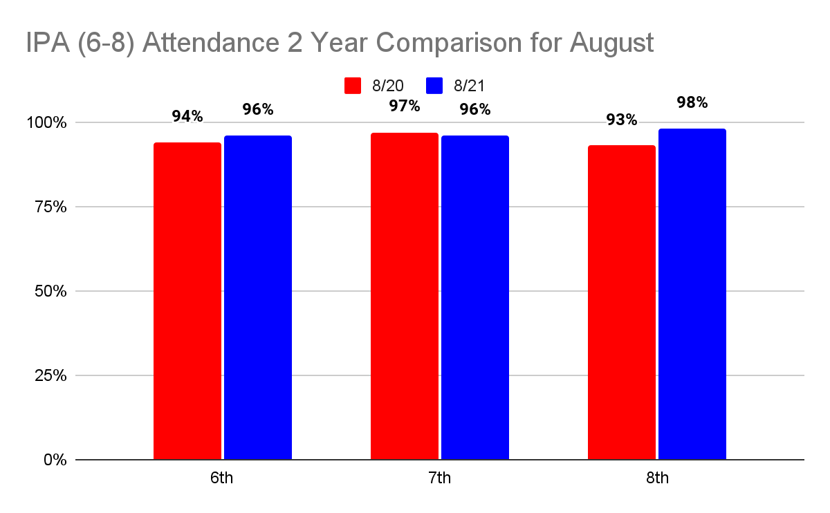
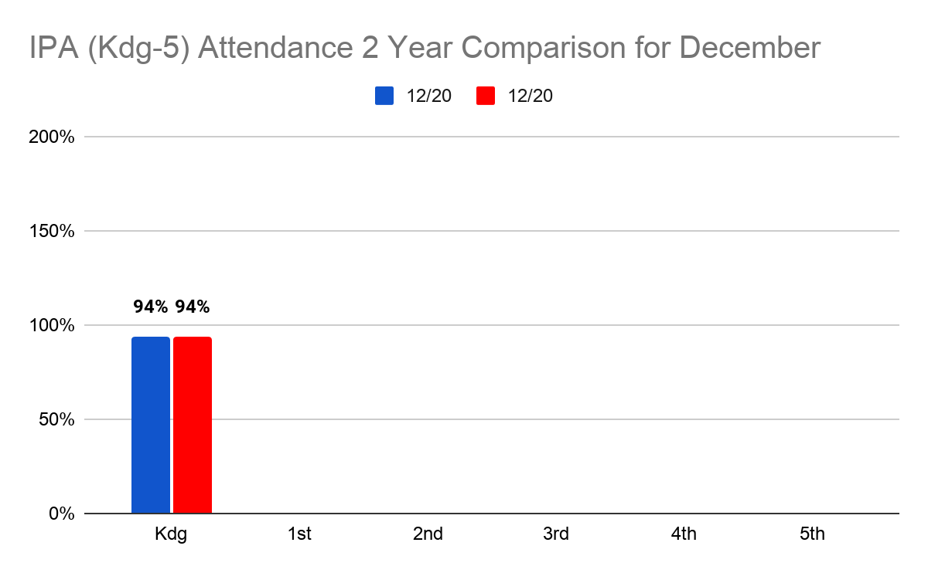

Slide 11
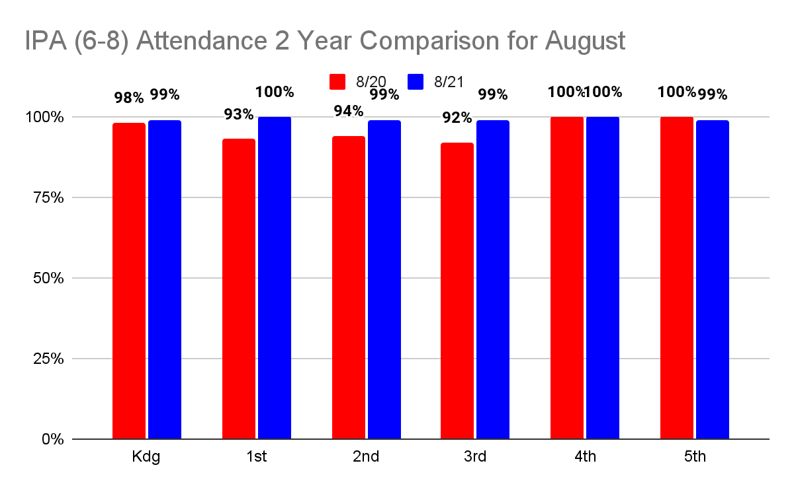

Slide 12
MARKETING & COMMUNICATIONS
ParentSquare has been implemented for all parents and staff
Pros
All communication in one place (academic notices will continue previous platform)
Daily Health Survey
Forms/Survey on one platform
Emergency alerts through one platform
*Emails/Texts will still go to all parents if they DO NOT have the app
Data:
349 (70%) Parents with app 445 (89%) Parents with emails
334 (67%) Receiving Notification through App 437 (87%) Receiving emails
491 (98%) Parents with phones-Emails and phone numbers are current. No failed attemps
66 (13%) Opted to receive texts

Slide 13
FY 22 BIG ROCKS
Focus for this year
Policies & Procedures
STREAM
Whole Girl Education
Thinking Maps
Learning Recovery
Tiered Professional Learning
Teachers: Content, Pedagogy & Differentiation
Leaders: Management, Time Management, Talent Management

Slide 14
Action Item
Approve changes to attendance policy
Approve flow chart for employee response to COVID
Approve renewal contractor

Slide 15
Important Dates
SCSC Meeting August 25, 2021 at 10:00 am
New Scholars’ Ceremony September 2nd at 6:00 pm virtual
SCSC Monitoring Submissions due by September 13th
EIP & REP Plan Completed by September 7th

Slide 16
Action Items
Approval of revised Dress Code Policy for Staff
Approval of revised Scholar Dress Code Policy for Scholars
Continue to review an Incentive Program for staff
Create a taskforce with external stakeholders for the development of a re-entry plan

Slide 17
Action Items
Approval of revised Dress Code Policy for Staff
Approval of revised Scholar Dress Code Policy for Scholars
Continue to review an Incentive Program for staff
Create a taskforce with external stakeholders for the development of a re-entry plan

