Slide 1
CFO Financial Report
February 2020 Financial Reporting
March 24, 2020

Slide 2
Board Meeting: February 2020
CFO Report
Monthly Financials:
Presentation of the February 2020 Financials.
Requesting approval of the February 2020 financials presented during the March 24, 2020 board meeting.
KIRKWOOD
FY20 Amended Budget:
The FY20 Amended Budget was approved during the February 25, 2020 board meeting.
Human Resources:
Continuing to focus on recruiting – utilizing GCSA, MightyRecruiter (our ATS) and Indeed.
Due to the school closing, the issuance and return of contracts was adjusted, however contracts have been issued.
Due to COVID-19 we will be revamping the hiring/recruiting process. We plan on utilizing technology as much as we can (IE. Google Hangouts, Paycor Onboarding Feature).
Admissions and Data Management:
Enrollment at February 2020 was 471 FTEs. Current re-enrolled scholars for FY21 is 389.
The lottery drawing was held March 14, 2020. All families have been notified of their status.

Slide 3
138 scholars confirmed from the lottery. Applications will re-open for new applicants the week of March 23, 2020.
Student Record, Student Class, and FTE are currently underway.
Resource and Development:
Resource Development submitted a plan called Vision 2025 which is designed to raise $2Million by 2025.
Funding proposal was submitted to the Tyler Perry Foundation to support our Performing Arts program.
The PLTW grant for $30K submitted has been suspended due to the Coronavirus pandemic.
Resource Development has adjusted its fundraising efforts during this shutdown; only seeking funds from public figures and those of high net worth.

Slide 5
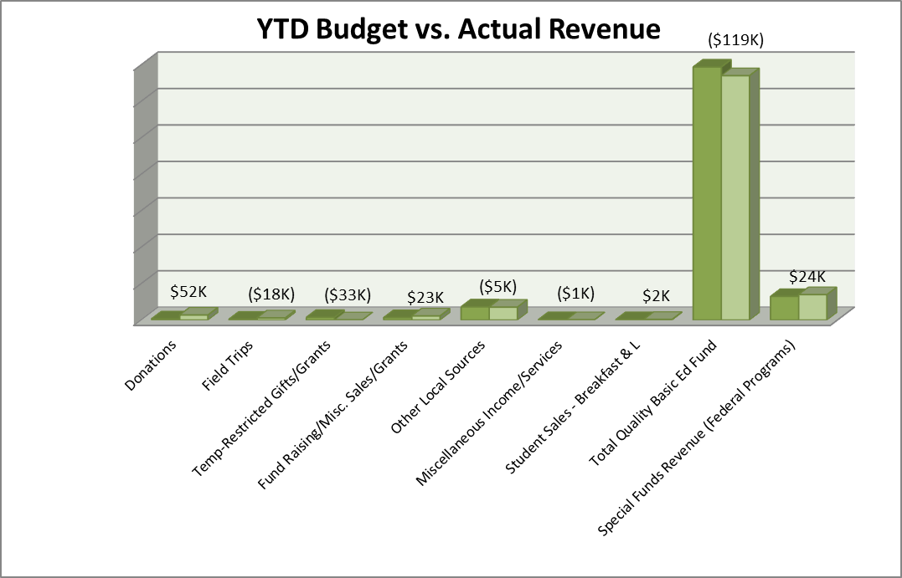
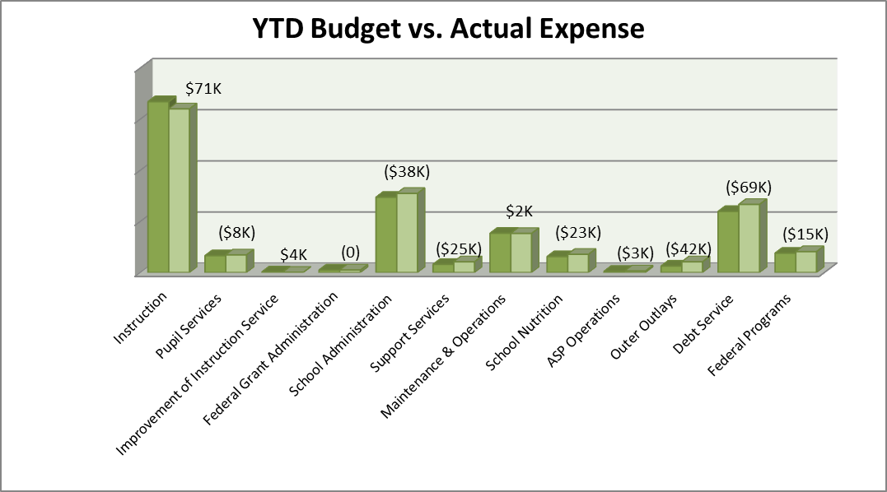
Note: Favorable/(Unfavorable) Variance

Slide 6
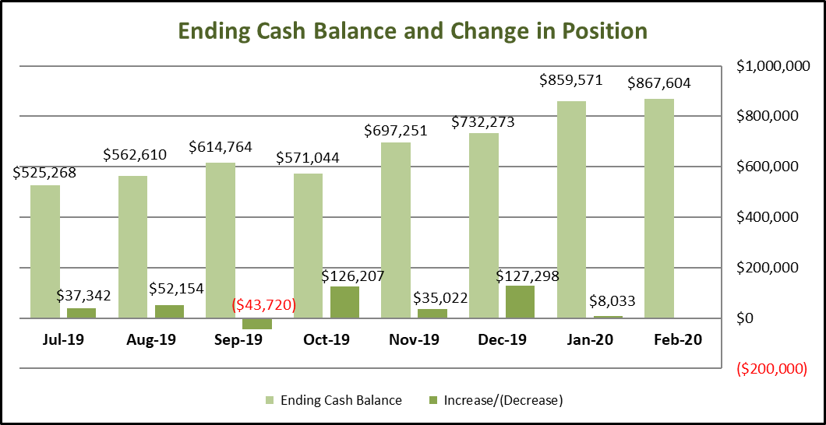
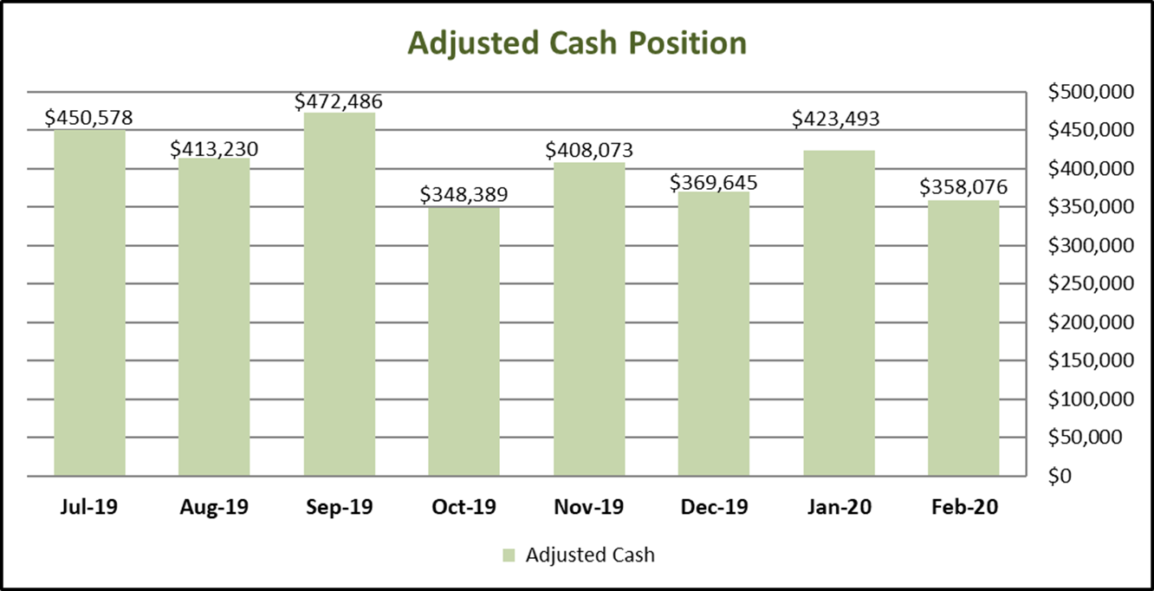

Slide 7
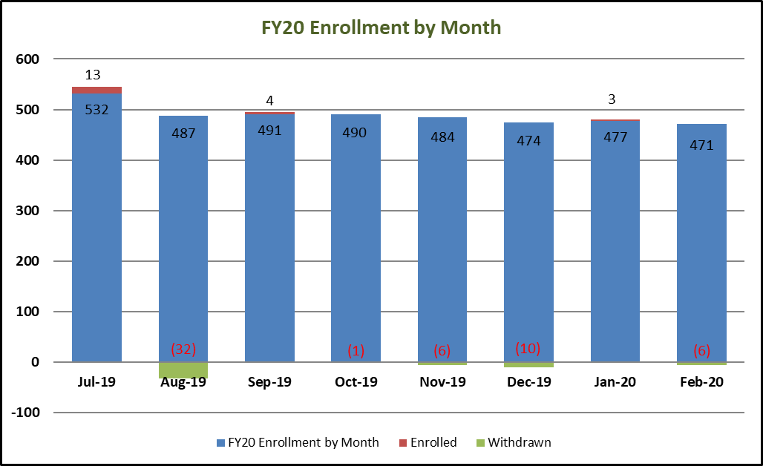

Slide 9
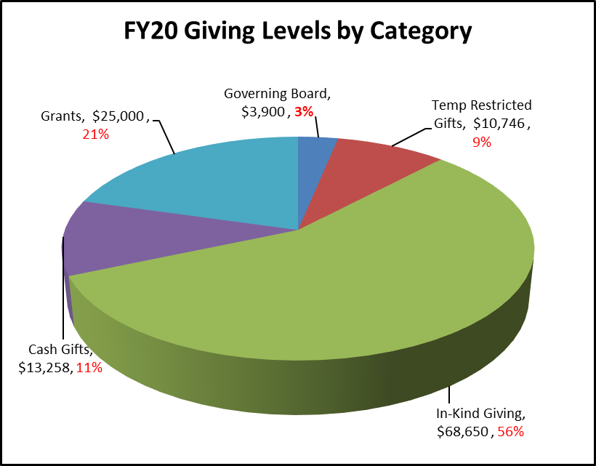

Slide 10
