Slide 1


PREPARED JUNE 2022 BY
January 2022 Financials

Slide 2
Key Performance Indicators
Current Days of Cash
Gross Margin
Grants Invoiced
Cash balance at end of month divided by average daily expenses
Revenue less expenses, divided by revenue
Federal grants requested divided by federal grants awarded.
83 DAYS OF CASH AT Month End
-2.8% GROSS MARGIN
53% GRANTS INVOICED
This is above the recommended 60 days.
Current net income is $-300k, which is $1.1m below the budget. It yields a -2.8% gross margin.
Drawdowns are scheduled to be submitted on a quarterly basis. Next round will be submitted at the end of June.

Slide 3
Financials Overview through May 2022
 | Forecast | Budget | Variance | Variance Graphic | Comments
Revenue | $11.5m | $11.4m | $19k
Expenses | $11.6m | $11.4m | -$285k
Net Income | $304k | $9k | -$295k
+19k
-285k
-$304k

Slide 4
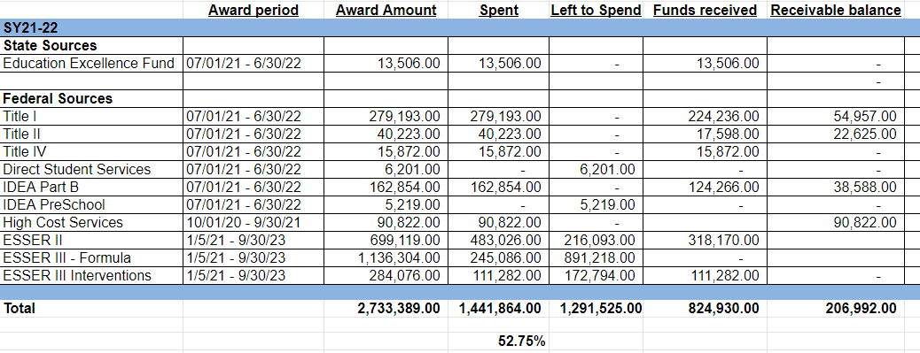
Grants Dashboard

Slide 5

QUESTIONS?
Please contact your EdOps Finance Specialist:
Darius Munchak
darius@ed-ops.com
504-800-8200
© EdOps 2017-2020

